Slide 1
Young Professional – Spain Section
Manuel Ballesteros
Chair YP IEEE Spain/ R&D Engineer at RF Explorer
m.ballesteros.carballo@ieee.org

Slide 2

NEW LOGO

Slide 3
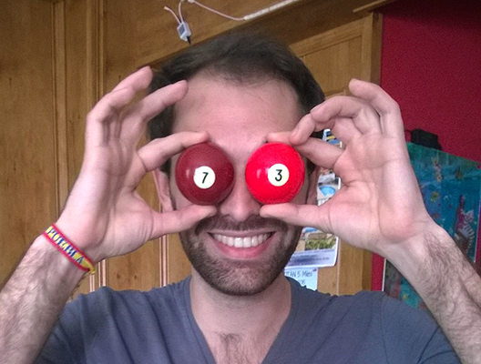
NEW YP Spain Team
Juan Emilio Zurita (Sevilla)

Slide 4
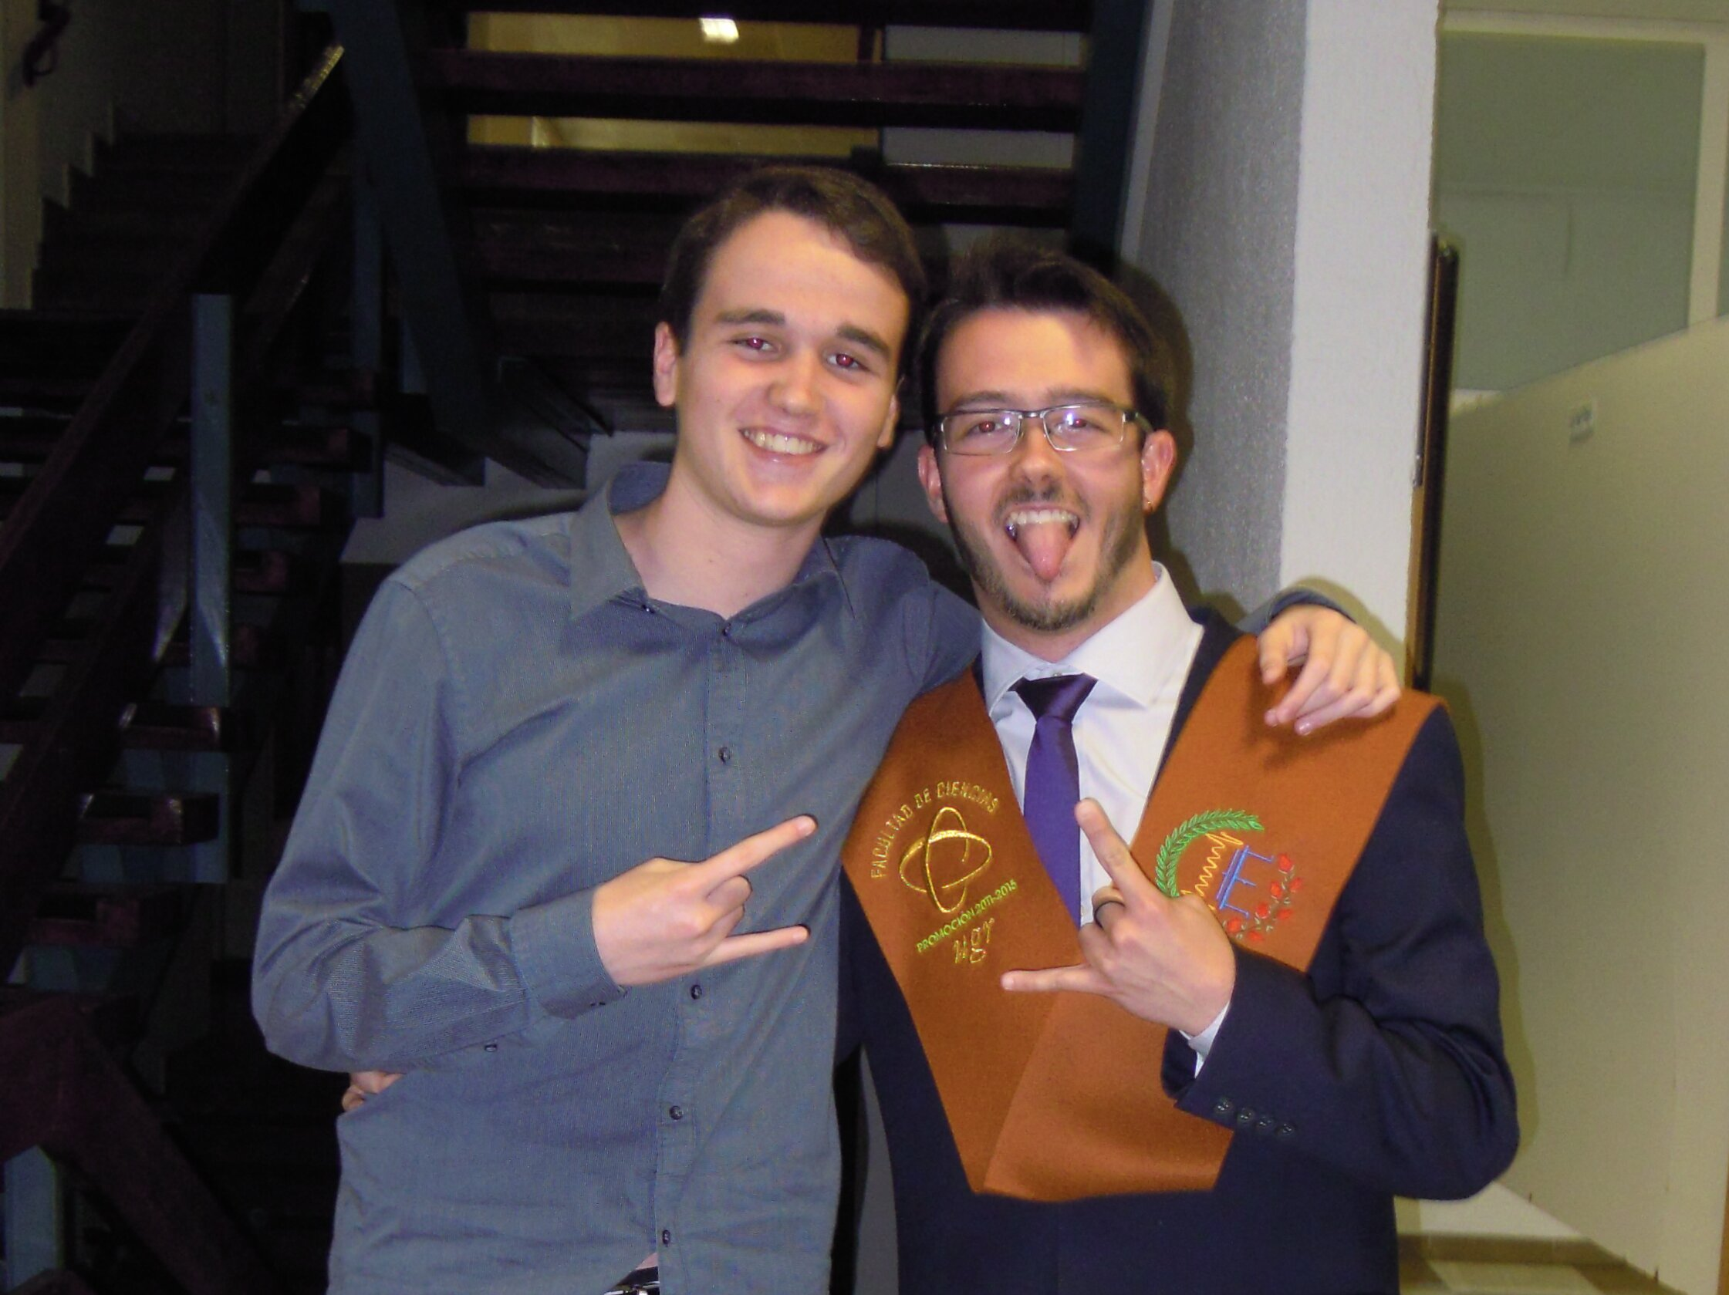
Jesús Rodríguez
(Granada)

Slide 5
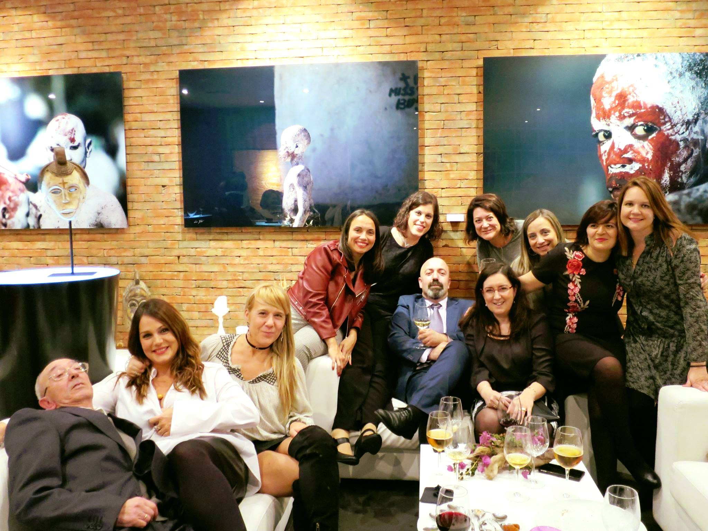
Ramón Carrasco (La Coruña)

Slide 6
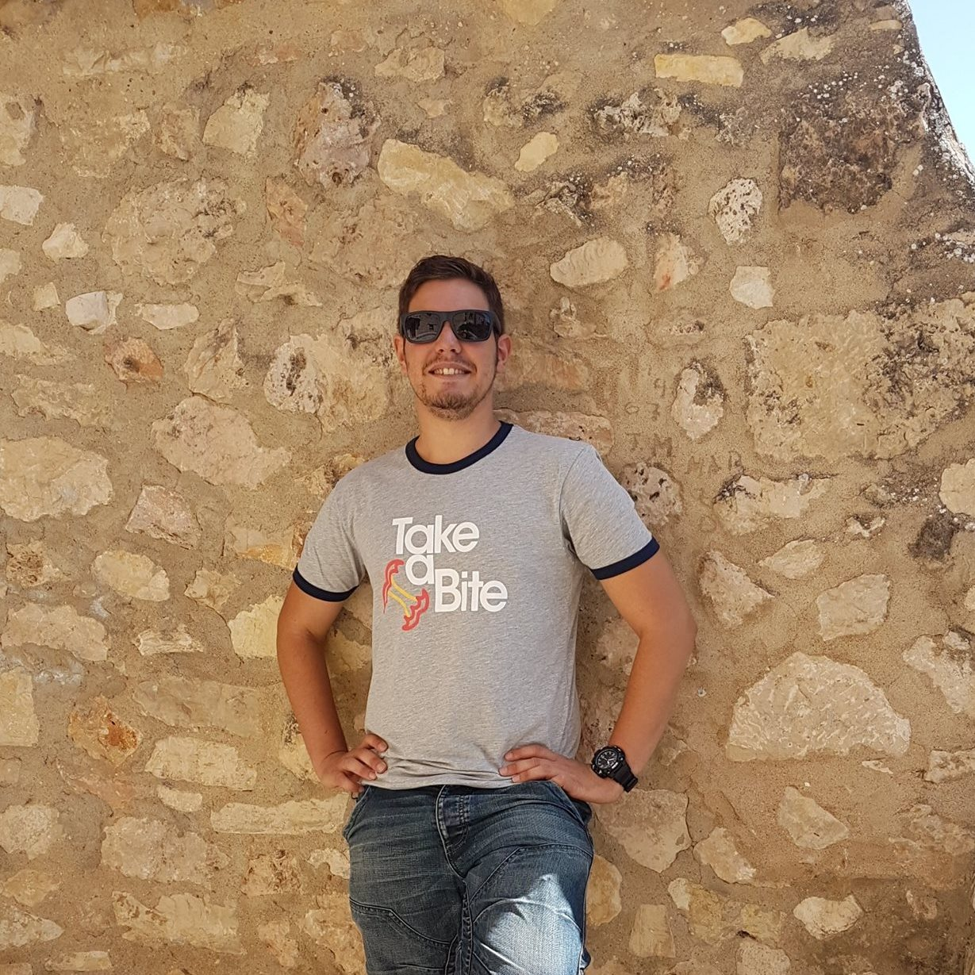
Emilio Gómez
(Elche)

Slide 7
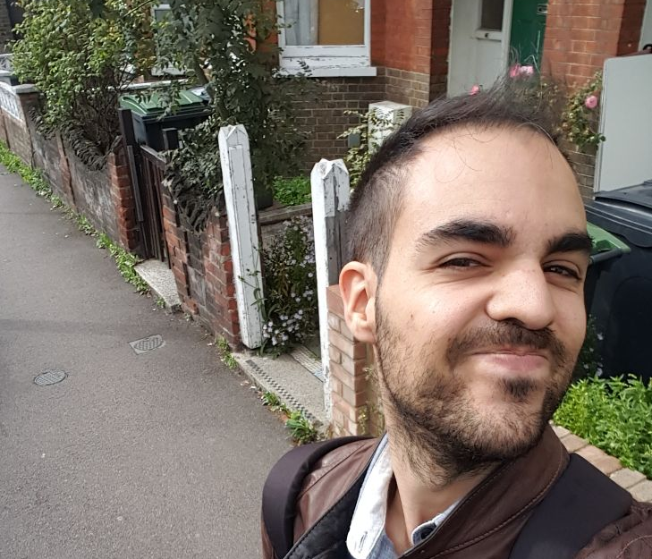
Rubén Martínez
(Cartagena)

Slide 8
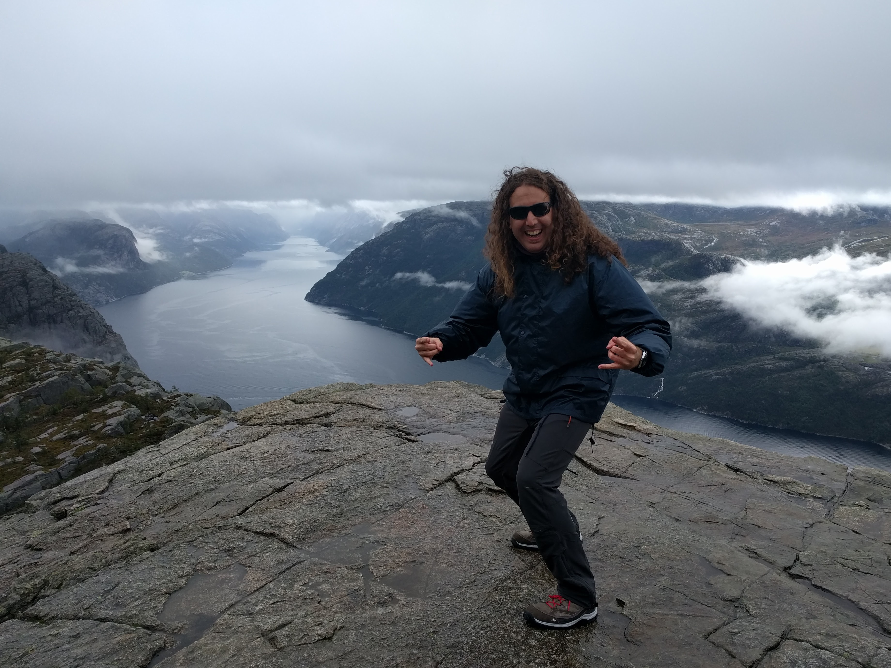
Manuel Ballesteros
(Madrid)

Slide 9

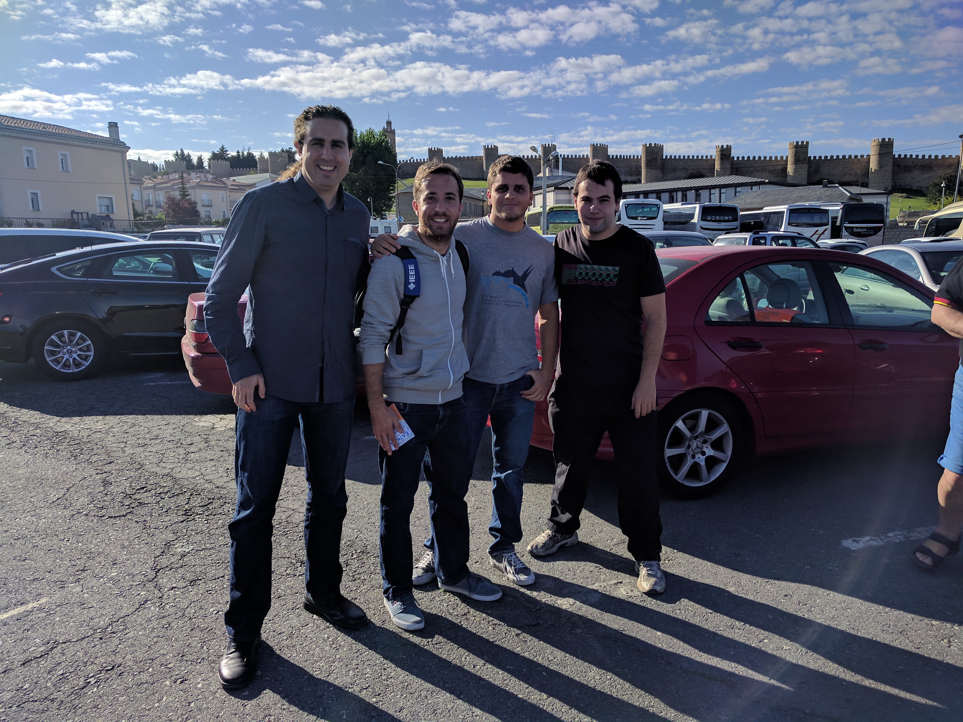
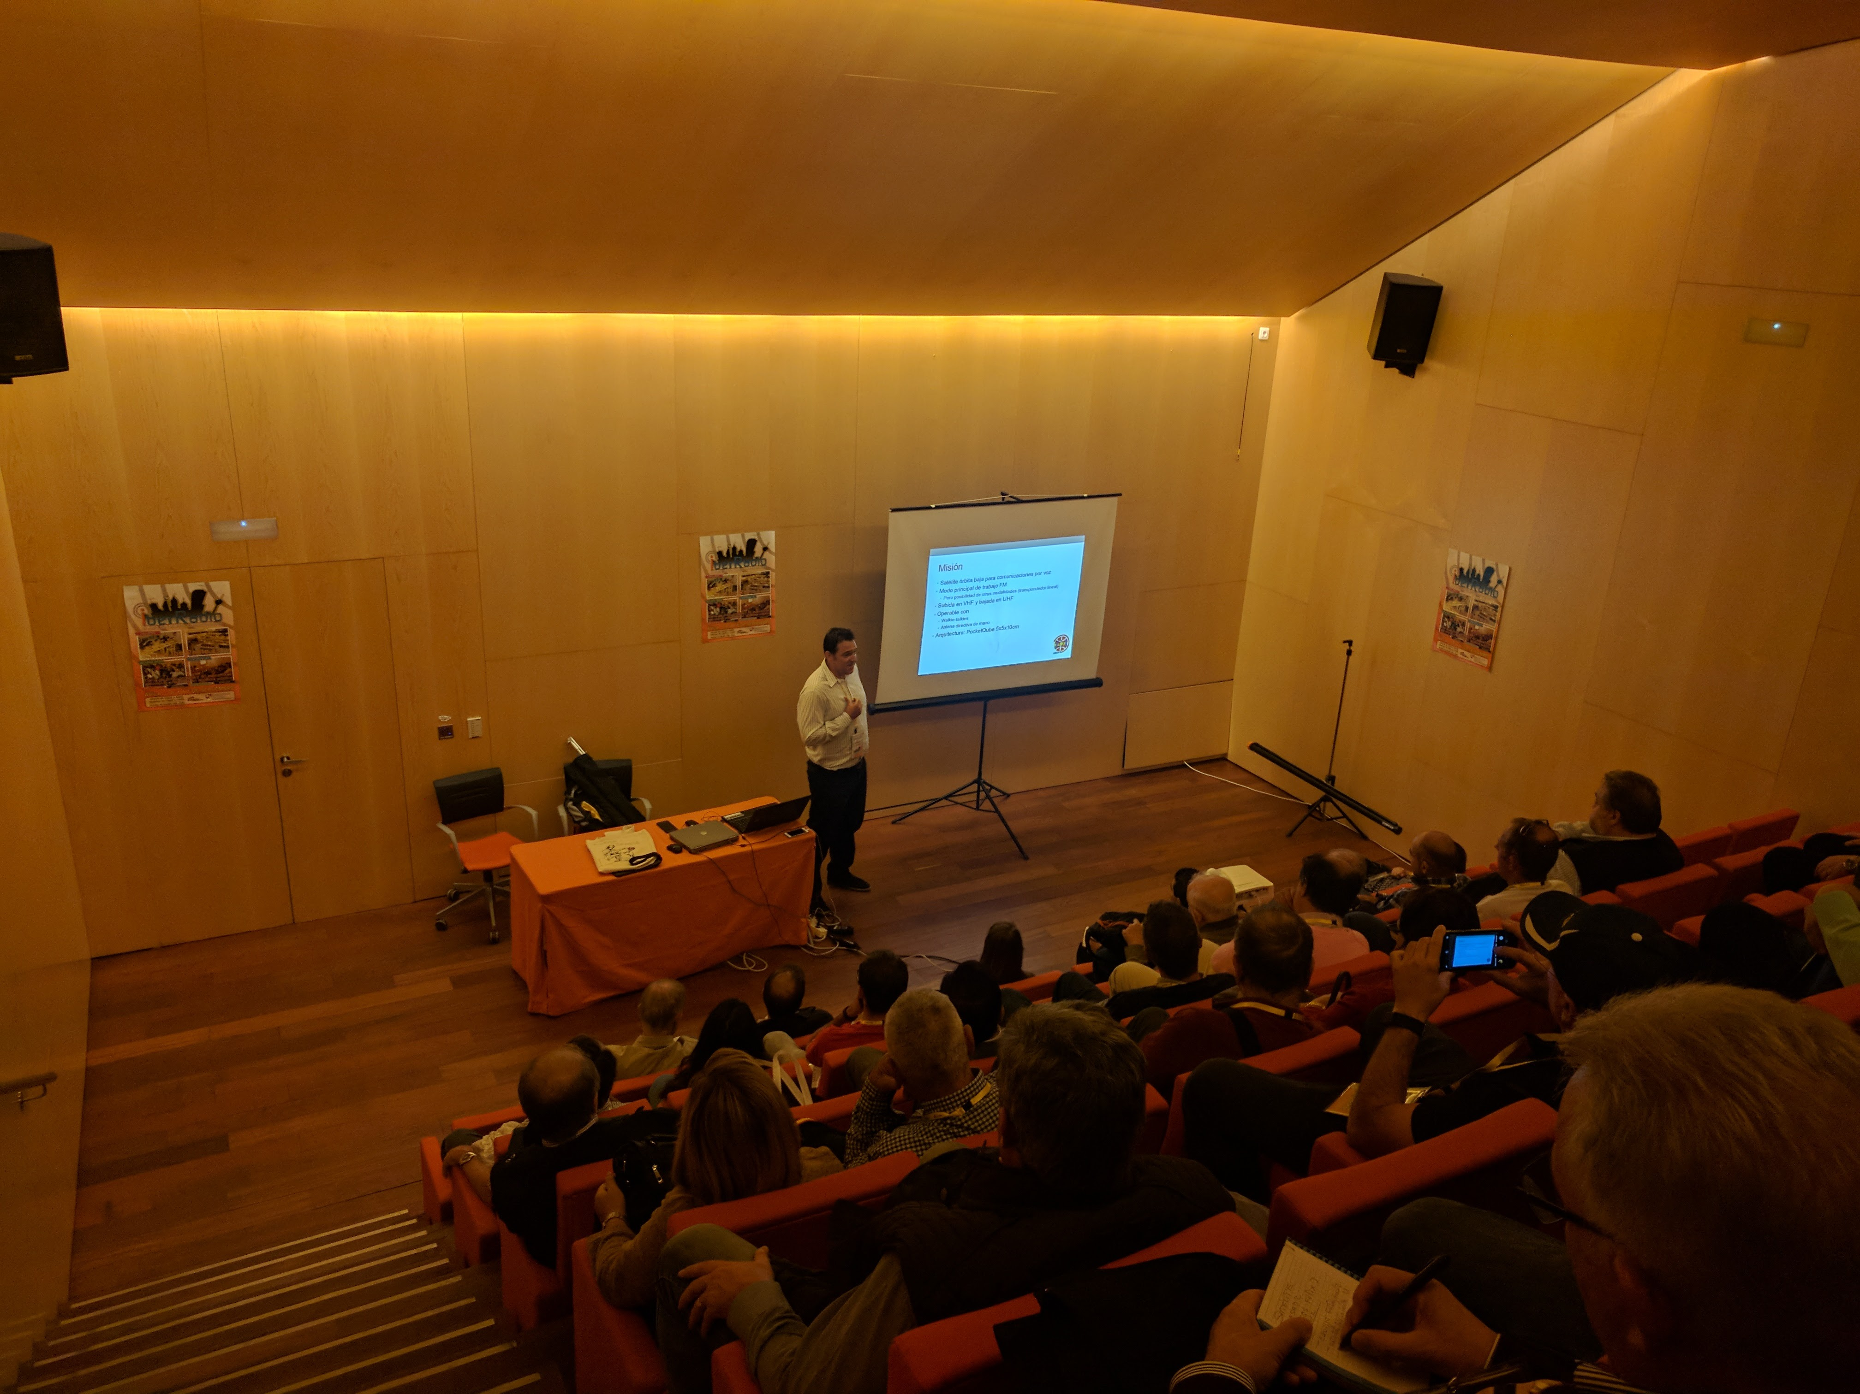
NEW ACTIVITY

Slide 10

NEW ACTIVITY
Innovative Project
Round Table + Networking

Slide 11
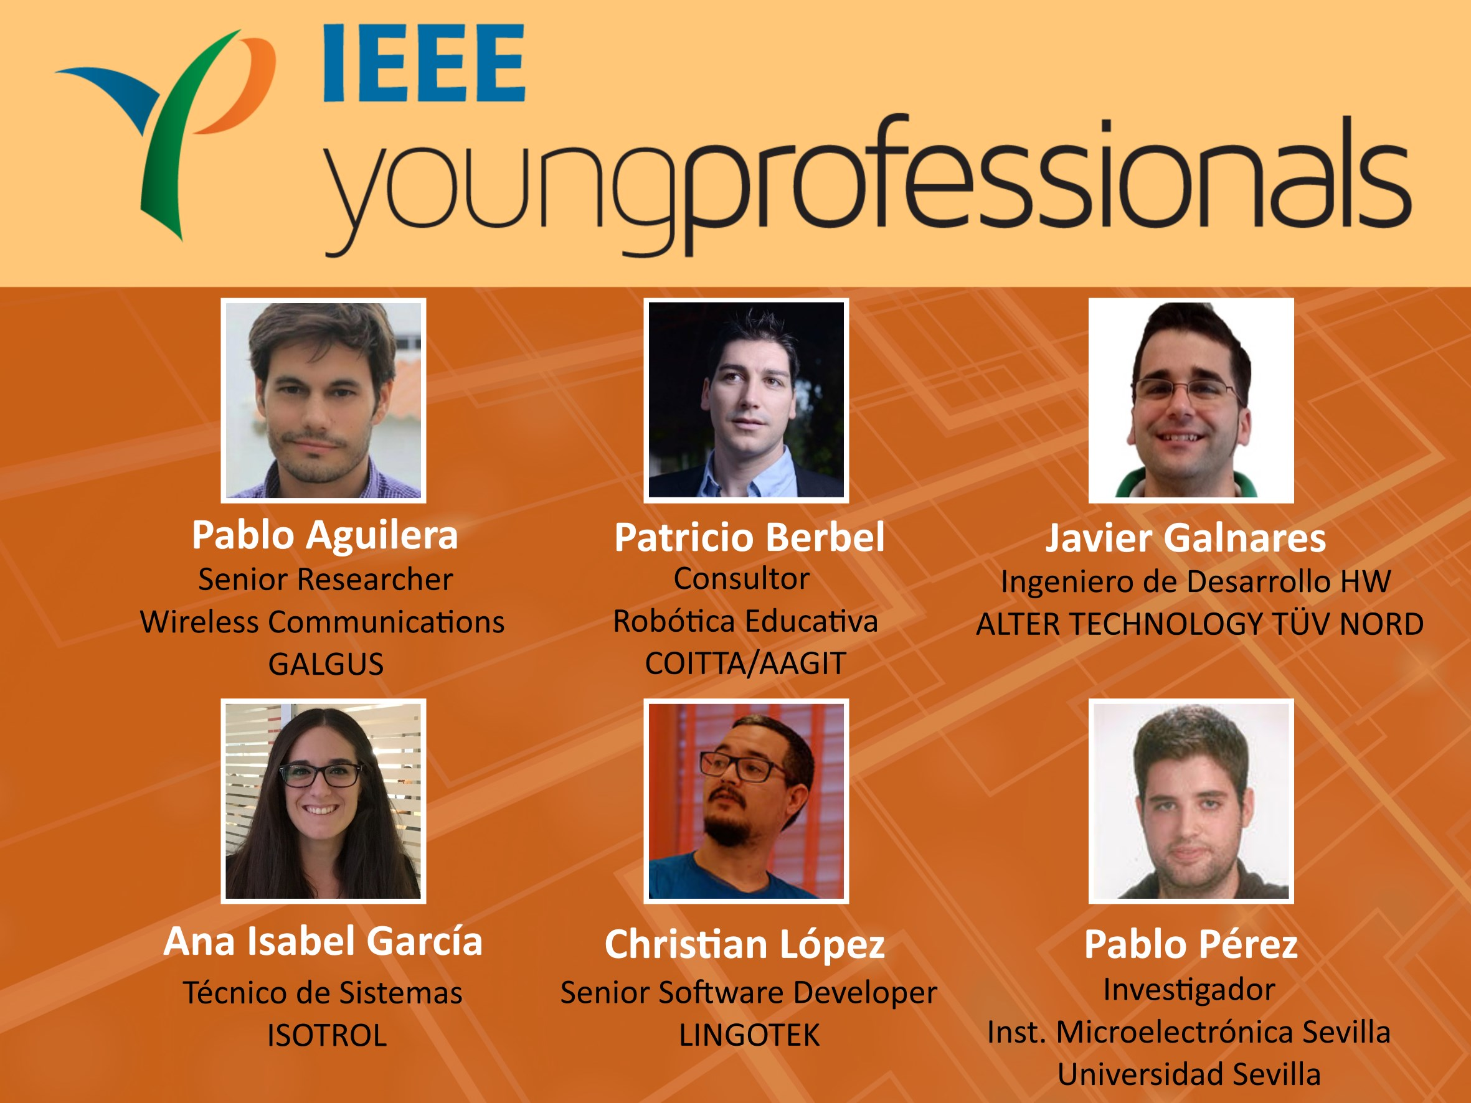

Slide 12
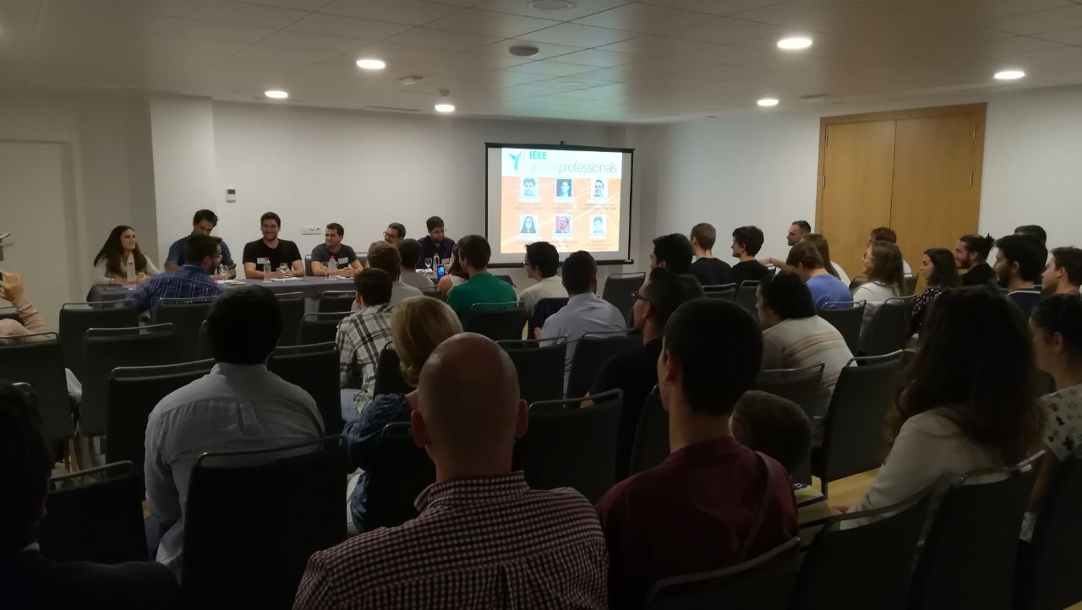

Slide 13
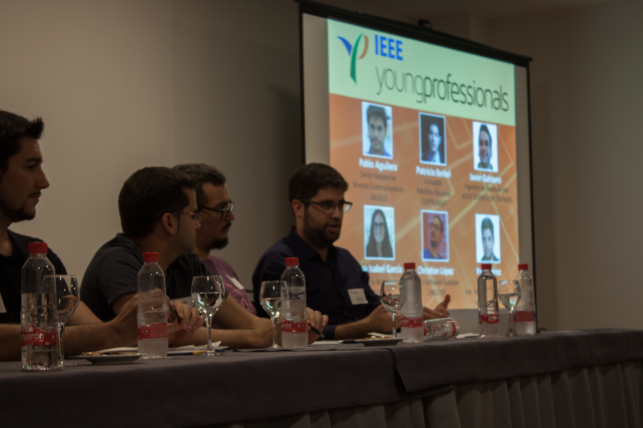

Slide 14
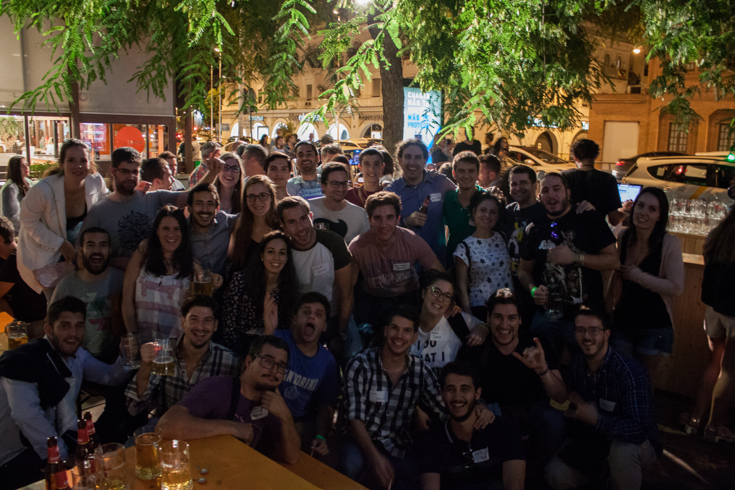

Slide 15
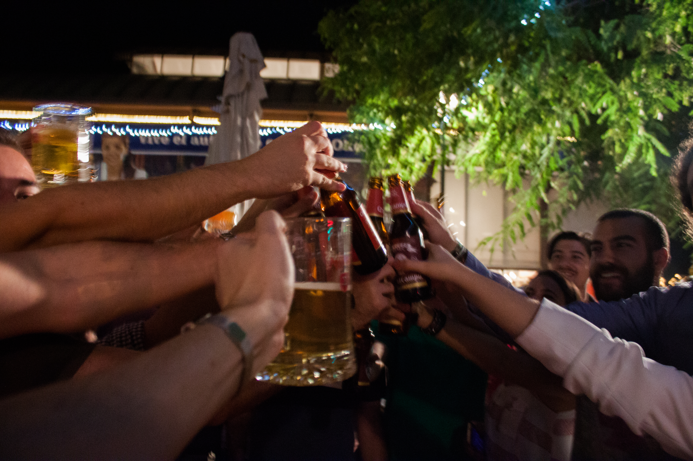

Slide 16


Slide 17


Slide 18

Enjoy!!!

Slide 19
Contact
Manuel Ballesteros
Mail m.ballesteros.carballo@ieee.org
Twitter @Mballest1
LinkedIn
Facebook

